Slide 1
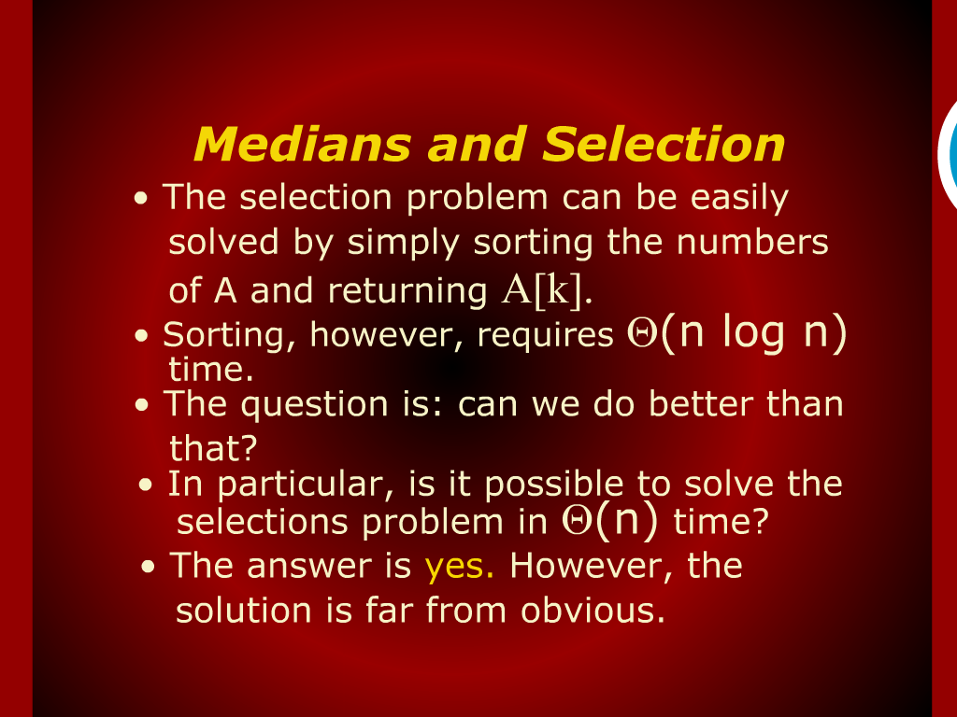
Medians and Selection

Slide 2
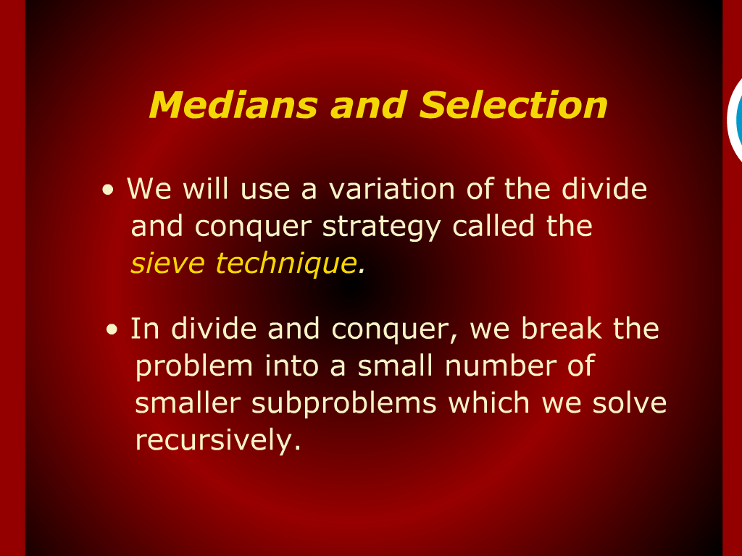
Medians and Selection

Slide 3
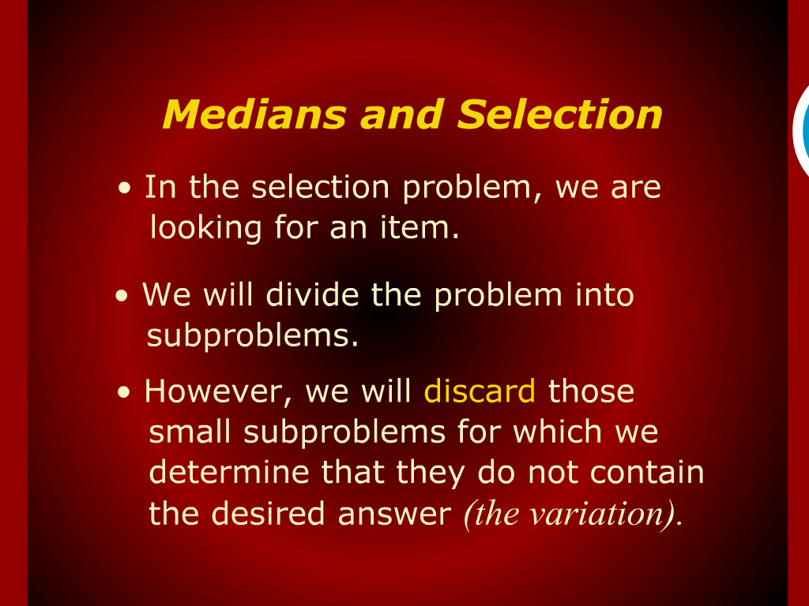
Medians and Selection

Slide 4
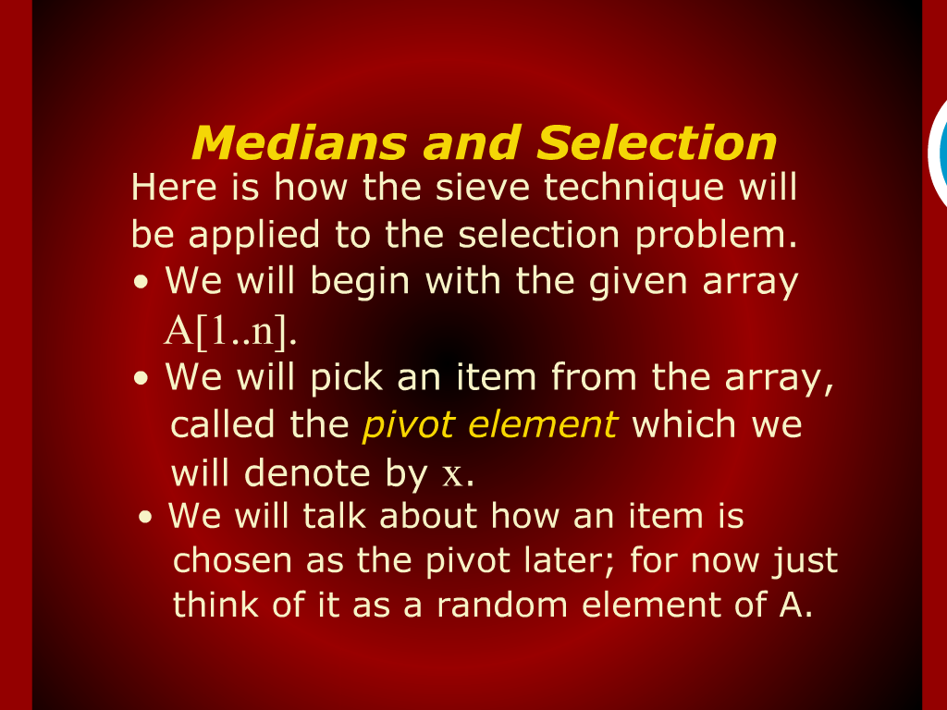
Medians and Selection

Slide 5
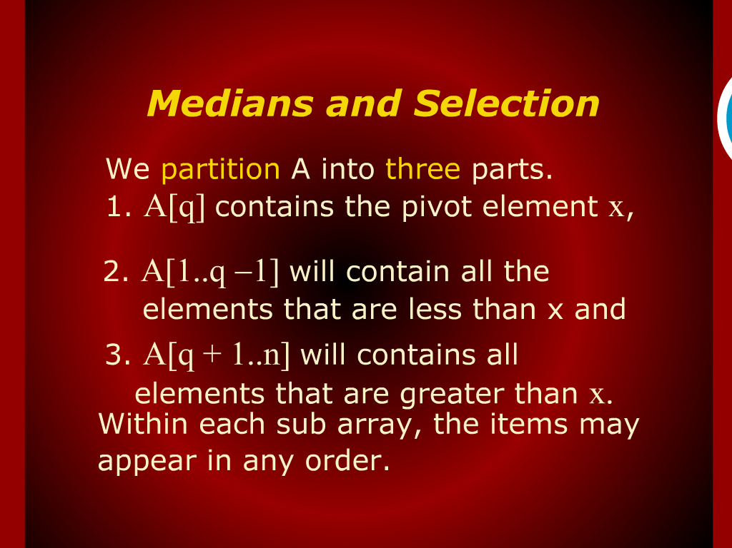
Medians and Selection

Slide 6
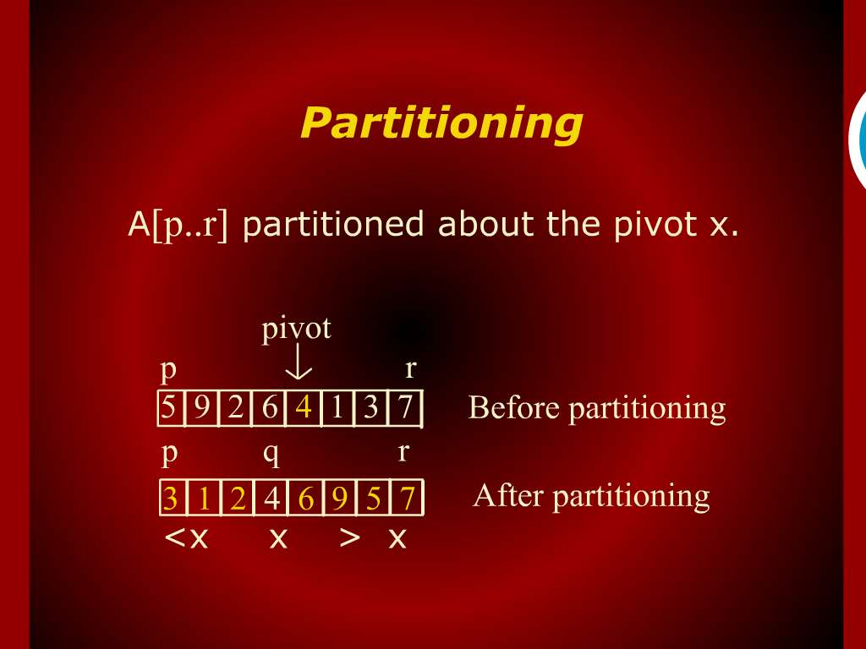
Partitioning

Slide 7
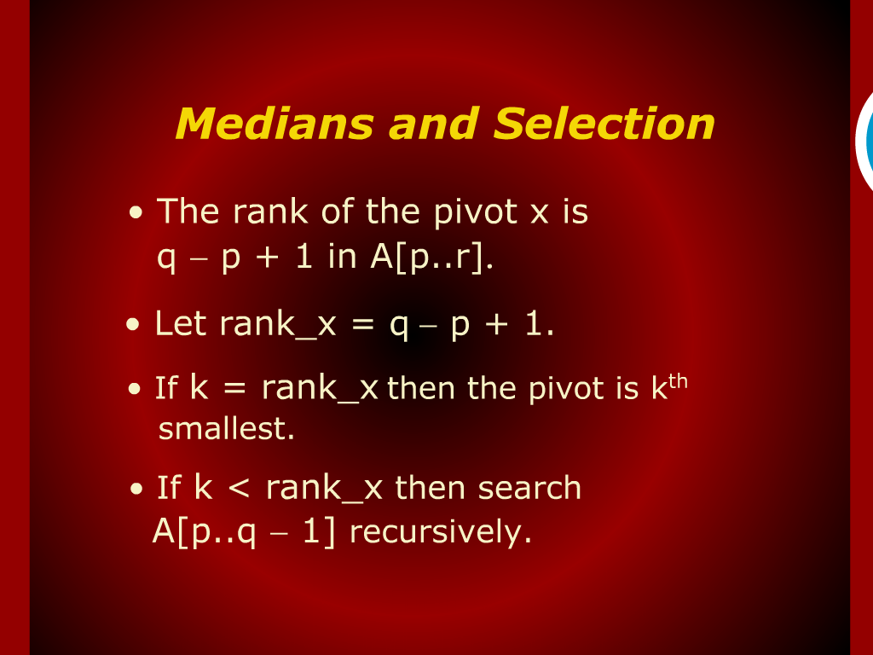
Medians and Selection

Slide 8
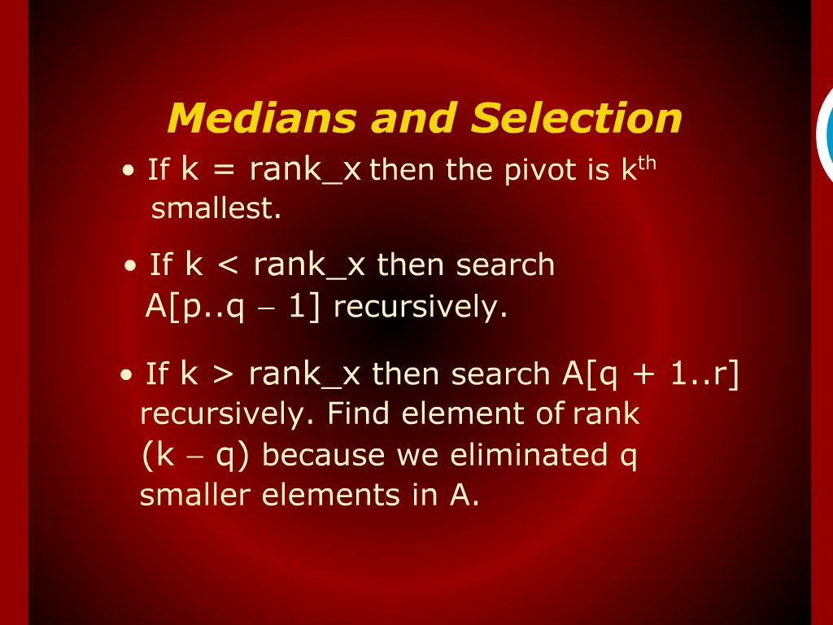
Medians and Selection

Slide 9
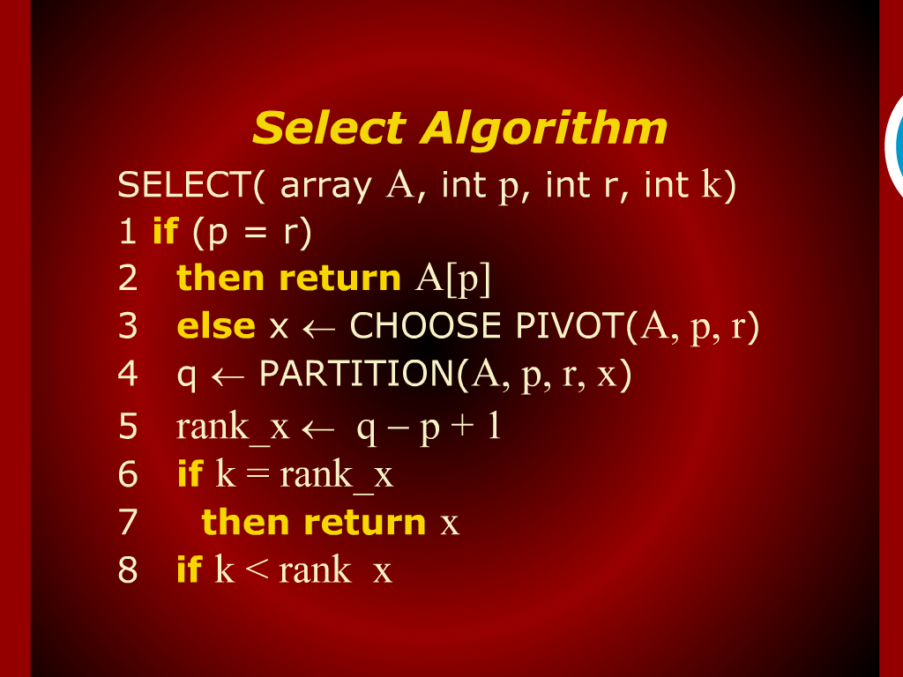
Select Algorithm

Slide 10
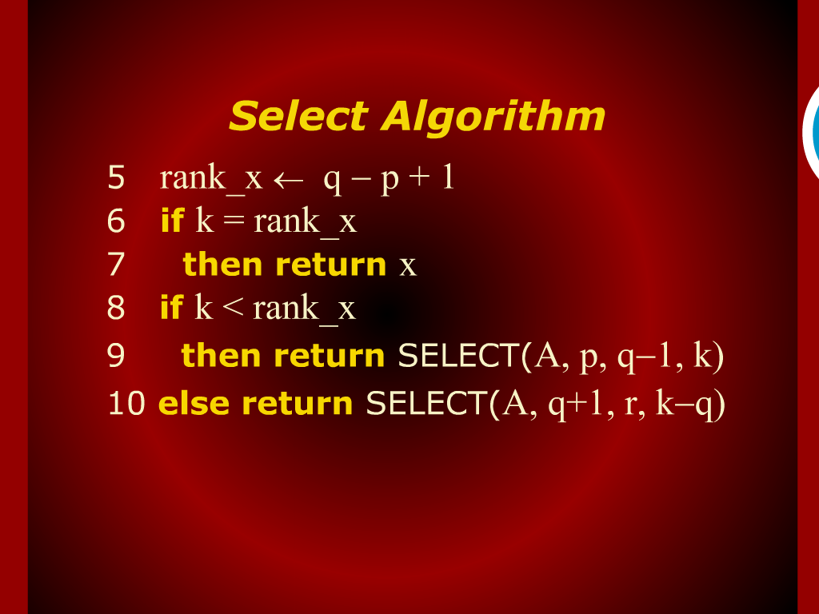
Select Algorithm

Slide 11
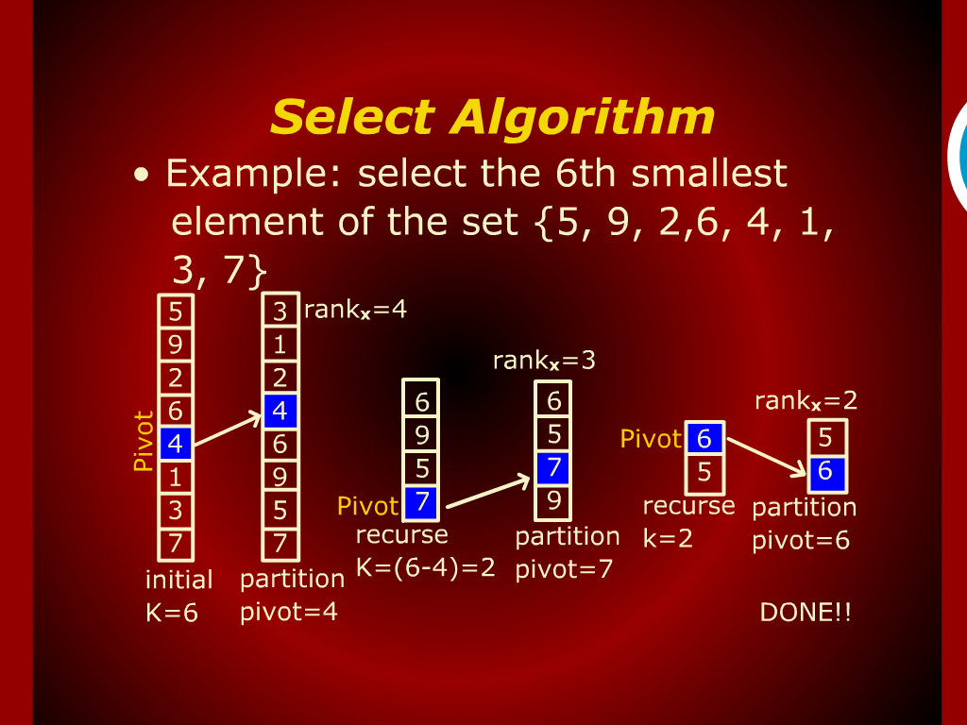
Select Algorithm

Slide 12
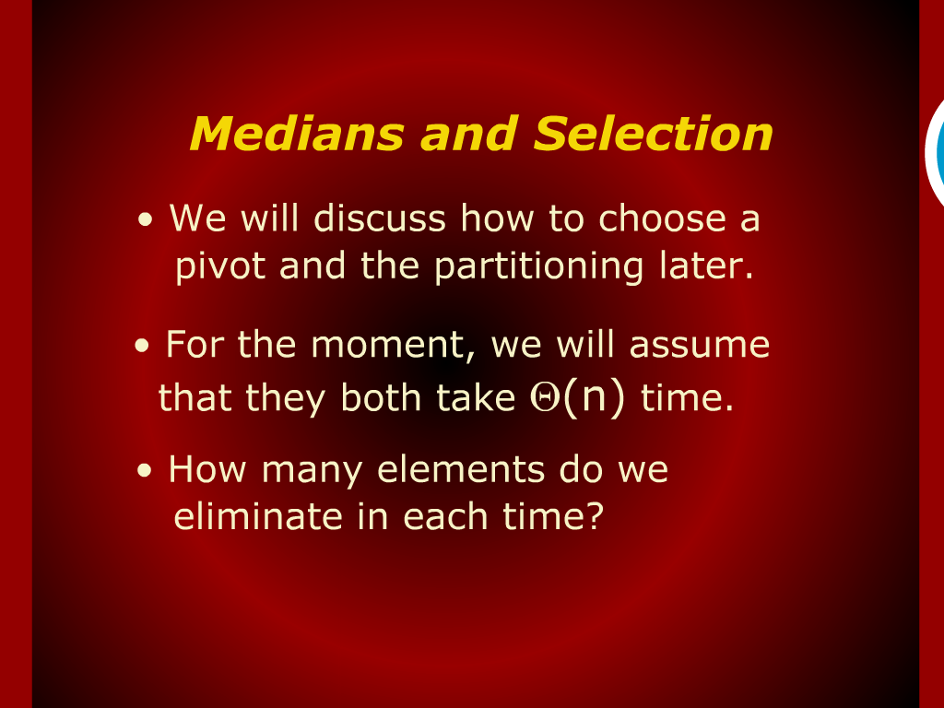
Medians and Selection

Slide 13
Steve Technique

Slide 14
Design
and
Analysis of Algorithm

